Slide 1
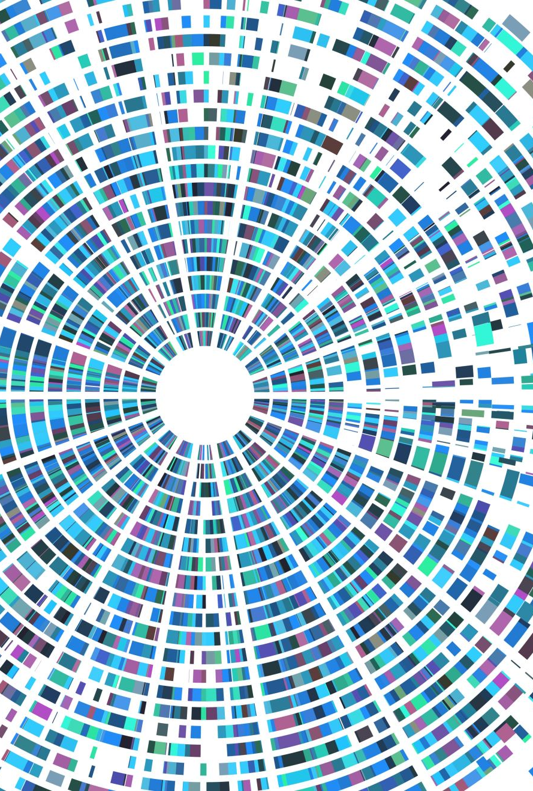
The Study of Lean in Healthcare Systems
By Andrei Bailes, Anthony Nguyen, Nicholas Ricci, Cody Brewer

Slide 2
Integrating Lean in Healthcare

Slide 3
Top-Down Implementation
Higher-Ups in management observe hospital staff in their working environment and takes notes.
As observations are made and compiled together, a team of analysts can study the data and make recommendations to improve any occurring errors.
Management would then create new processes, deploy these processes, receive feedback on these processes and conduct new observations

Slide 4
A Culture of Continuous Improvement
Management would inform hospital staff of new standardized processes created from the analyzed data
Checklists can be created for staff to follow and reference afterwards to see if they are keeping up with the standard procedures set forth by management.
For Example, a medical advisor in training would use the checklists to ensure they are following the proper procedures as they gain experience in their position.

Slide 5
Extra Recommendation
Surveillance on high-risk patients that alert staff if there is an emergency. Reducing the response time of medical staff to an emergency.
Hospital staff could act out scenarios with each other in-order-to train themselves to better understand what a patient needs in different situations. This can help improve diagnosis time if staff are more aware of the different the forms patients can present in.
Finding a way to streamline the paperwork patients need to fill out when they come to the ER, reducing the stress on the patient and creating a better experience for them.

Slide 6
The Importance of Lean Integration in American Healthcare

Slide 7
What is Lean?
Lean is formulated to reduce wastefulness in a process by standardization and other principals
This encourages a culture of sustainability and growth
This leads to a continuous reduction in errors that occur in processes.

Slide 8
Why is Lean Important in Healthcare
Processes that are too long or complex or that haven't been reviewed can contain wasteful or redundant tasks
These wastes can delay life-saving treatments for patients
Lean identifies these wastes and works to eliminate them through a variety of methods
With these wastes eliminated hospitals can provide better, more efficient, treatments leading to better patient outcomes and higher overall satisfaction
Higher satisfaction means patients will return to the hospital when they are sick or injured

Slide 9
Process Mapping
Notes:
So now that we have learned about the importance of Lean lets go through the process mapping.

Slide 10
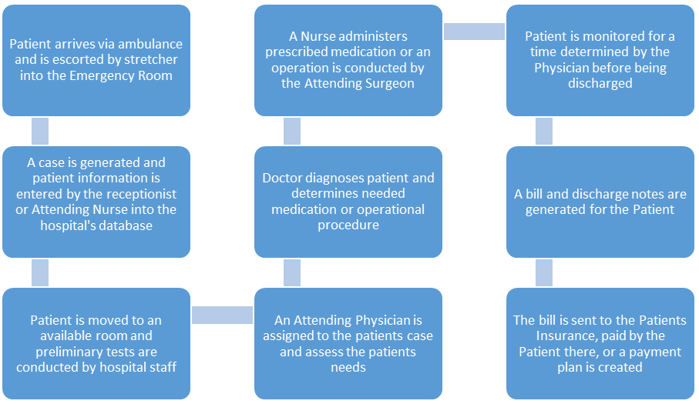
Process Map for a Patient Entering the Emergency Room
Notes:
So here we have the process map for a patient we see the patient arrive at the hospital we escort them to the emergency room we figure out what exactly is wrong and that info is given to the receptionist and then we move him to a room, get a physician to access the patients needs, diagnose him, we prescribe him medicine, we make sure they don't blow up, charge em, sent the bill. That is what almost every hospital has to do when a patient is present.

Slide 11
The Inputs, Outputs, and Main Process
Inputs = Patient Arrival
Process = Case is generated -> Patient is moved to a room -> Physician is assigned to the case -> Patient is diagnosed -> Prescription is ordered, or surgery is scheduled -> Medication is administered, or surgery is conducted -> Patient is monitored
Output = Bill and discharge notes are generated ->Patient is billed and discharged
Notes:
Ok so what are our inputs what are we getting in... patients. Now we go through our process this takes up most of our time. This is the main purpose of being here for the patients to figure out what they got. Then its payday we get paid by most likely the insurance company unless they decide not to pay. Now we go to the DMAIC Interpretation.

Slide 12
DMAIC Interpretation

Slide 13
General DMAIC Process
D – Define the problems that is occurring in the healthcare system
M – Measure the waste in the healthcare system in terms of numerical data
A – Analyze the data to generate better hypotheses on why the errors are happening in the healthcare
I – Improve the healthcare process after the analysis of the data
C – Control the process to ensure continuous improvement in the healthcare system

Slide 14
DMAIC For Long Wait Time
D – There is excessive wait time in the healthcare system
M – The average wait time for a consultation was 112 minutes
A – Out of the total patient time, approximately one-half is spent waiting with consultation taking up most of the waiting time
I – Create a color code for each patient for the responsible physician and training the physician to identify their own patients with colored dots
C – Have periodic tests and another DMIAC review of the system to ensure that the new process is functioning to standard

Slide 15
Chosen Effective Principle

Slide 16
Toyota Principle #12
"Go and see for yourself to thoroughly understand the situation." Known as 'Genchi Genbitsu’

Slide 17
Why Principle 12 is Important
It allows observers to see where the mistakes and wastes in a process are and gives them a better understanding of the possible causes.
It is effective because workers can gain a much better understanding of how the process works by seeing it with their own eyes compared to just being told about it.
Continuous improvement can be implemented on a regular basis and the root cause of the errors will be better identified.

Slide 18
References
Sasha Evdokimov RT(N)(CT), personal communication, Nov. 19, 2022
Sisson, J. and Elshennawy, A. (2015), "Achieving success with Lean: An analysis of key factors in Lean transformation at Toyota and beyond", International Journal of Lean Six Sigma, Vol. 6 No. 3, pp. 263-280.
GoLeanSixSigma.com. (2020, October 29). DMAIC – The 5 Phases of Lean Six Sigma. Retrieved November 9, 2022, from https://goleansixsigma.com/dmaic-five-basic-phases-of-lean-six-sigma/
Camp, R. (2016, July 4). Toyota Principle #12: Go and See. Getting to Lean. Retrieved November 10, 2022, from http://gettingtolean.com/toyota-principle-12-go-and-see/
Virginia Mason Institute. (2022, January 27). What Is Lean Healthcare? Virginia Mason InstituteTM. Retrieved November 10, 2022, from https://www.virginiamasoninstitute.org/what-is-lean-health-care/
Talend. (n.d.). Lean Integration: What it is and Where it’s Going | Talend. Talend - a Leader in Data Integration & Data Integrity. Retrieved November 11, 2022, from https://www.talend.com/resources/lean-integration/

